Slide 1
goalkeepers: everything but goalkeeping
Theodoros Ioannidis, 3626

Slide 2
Contents
Data Set Description
Primary Goals
Playing with KPIs: Good and Bad Practices
Pressing Evaluation
Summary

Slide 3
Data set description
Custom dataset
Premier League Individuals (goalkeepers only) and Team performance for 2022/23 season until World Cup Break, November 13th
Data taken by FBREF (goalkeepers) and Opta Analyst Data Hub (teams)
In order to keep results relevant, I set a minimum 90-minutes played threshold, on 7 (roughly 50% of matchdays)

Slide 4
PRIMARY GOALS
The primary goal of the project is to identify the influence goalkeepers’ playing style has on their respective teams and vice versa.
I am going to evaluate different aspects of the game, such as levels of pressure, passing, and overall game dominance. During this evaluation, the target is to find the correlation between individual and team attributes.

Slide 5
Playing with kpis: Good and bad practices
KPIs (Key Performance Indicators) are the most profound way of measuring various aspects of the game and concluding to results. However, these results may be flawed, if not used correctly.
In order for a KPI to be relevant, we should define:
Context
Field knowledge

Slide 6
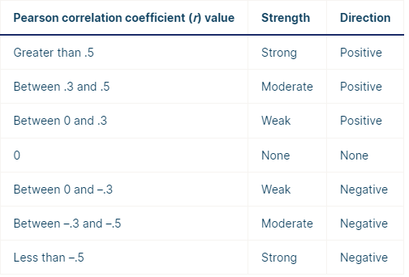
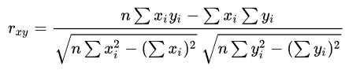
pearson correlation coefficient (r)
Most common correlation rule to measure the degree of the relationship between linearly related variables.
Pearson r correlation formula:
n = number of observations
x_{i} = value of x (for ith observation)
y_{i}= value of y (for ith observation)

Slide 7
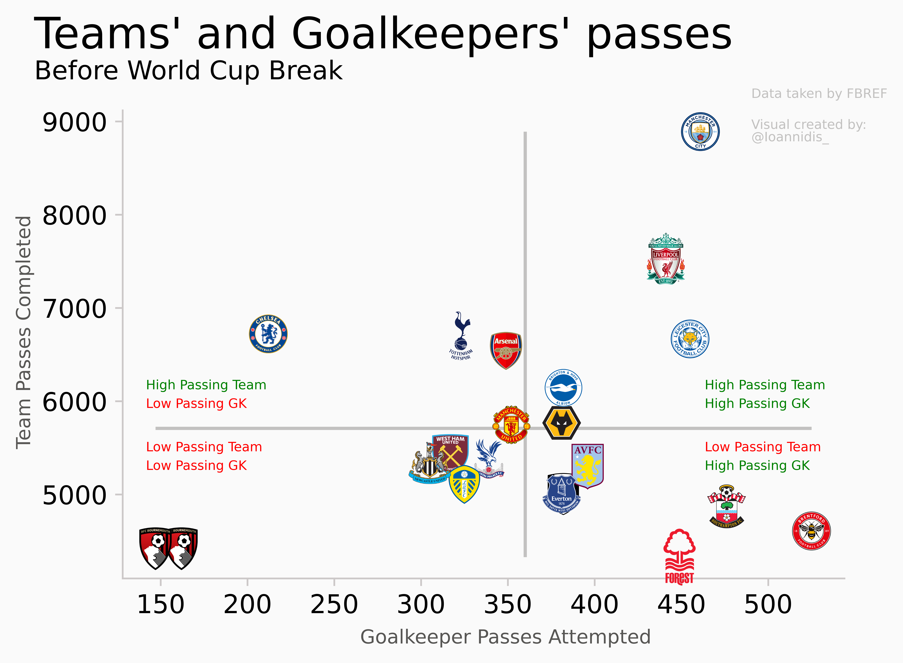
Good vs Bad practices
Bad Practice: number of passes on its own is a poor way to evaluate… anything really

Slide 8
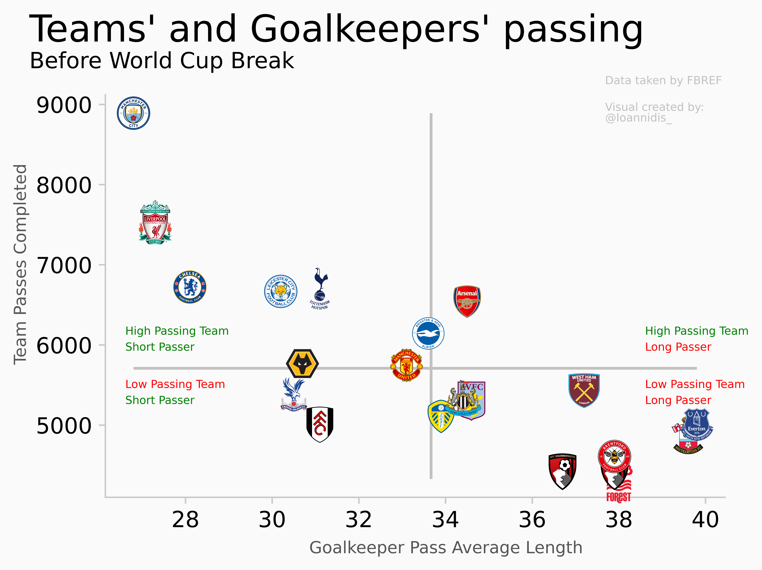
Good vs Bad practices
Good Practice: Pass average length is a better way to evaluate Goalkeeper’s influence on team’s build up

Slide 9
Good vs Bad practices
Using the Pearson r Correlation rule, as explained above, we can prove that team passes are strongly correlated with goalkeeper pass average length, while there is no strong correlation with the number of their attempted passes.
Applying it to the bad practice scenario, the result is 23.1% , while in the good practice scenario, the result is -80% .
So, we can see that there is strong negative correlation between goalkeeper pass average length and team passes completed, meaning that teams who pass the ball more, tend to have goalkeepers who prefer short passes.

Slide 10
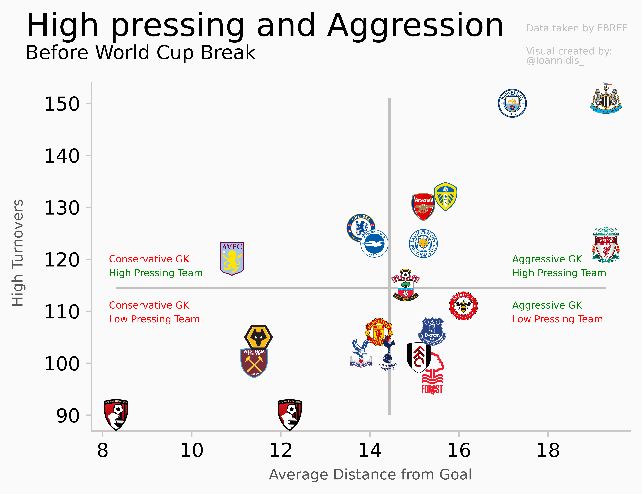
Pressing evaluation: HIGH UP THE FIELD
In order to evaluate pressure high up the field, I am using high turnovers for the teams and average distance of a defensive action outside of the penalty area for goalkeepers.
Using the same method with previous instances, there is a 63.9% correlation, which is higher than 50% threshold, meaning that the two metrics correlate strongly.

Slide 11
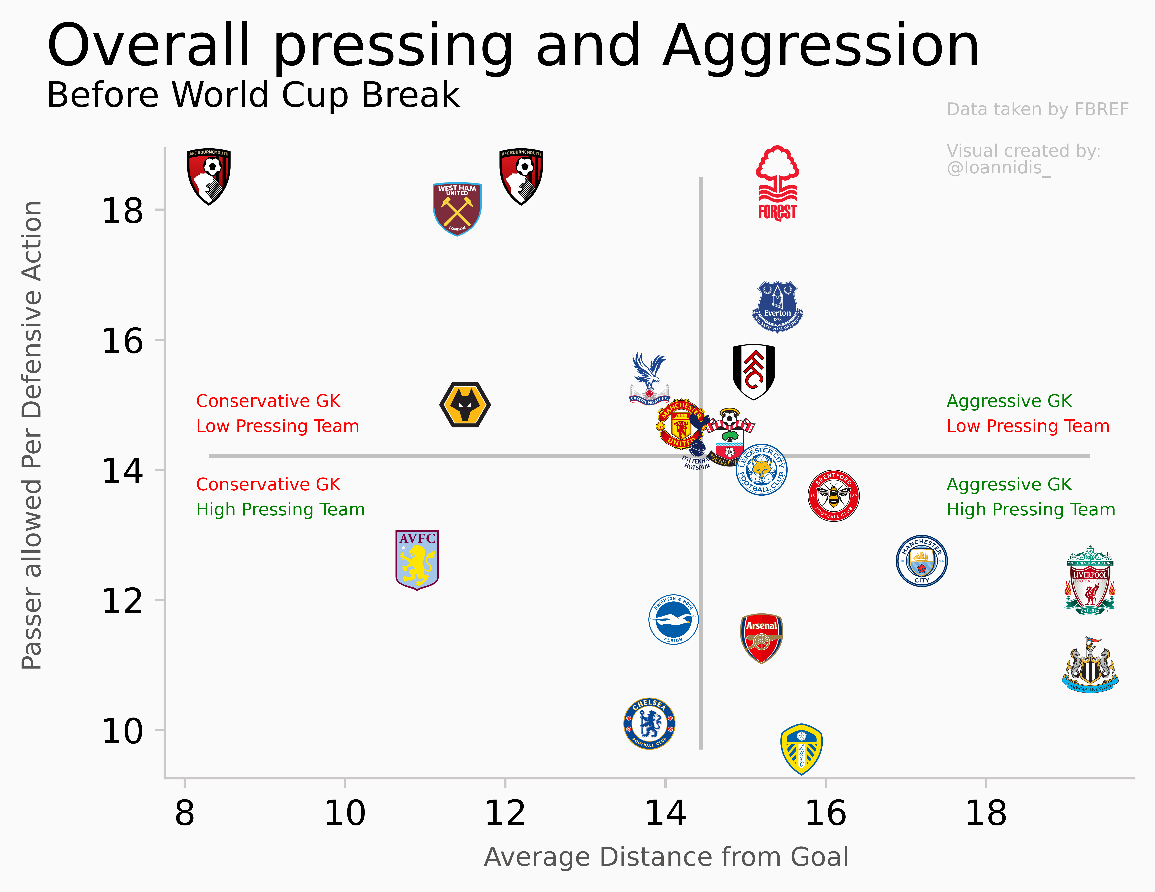
Pressing evaluation: Intensity
To calculate pressing intensity, we are using PPDA (Passes allowed Per Defensive Action) and average distance of a defensive action outside of the penalty area.
There is a strong negative correlation between the two metrics(-50.8%), which can also be backed up by the correlation between PPDA and High Turnovers, -84% according to Pearson r.
Even though transitive property of correlation is not guaranteed, it is highly likely to apply.

Slide 12
summary
In today’s football, goalkeeper duties are not limited to shot stopping, but include a series of outfield attributes, both off and on the ball. With correlation analysis, I was able to prove the influence of these very attributes both on teams and goalkeepers. In the last part of the presentation, I decided to review the correlation between metrics used and expected Goals (xG) difference. Expected Goals is a statistic used in football to measure the quality of a scoring opportunity. It assigns a value between 0 and 1 to each shot taken, based on factors such as the location of the shot, the type of shot (e.g. header, direct free kick), and the type of assist (e.g. through ball, cross). xG Difference is the difference between the xG value a team produced minus their opponents’ xG.
Average Distance of a Defensive Action Outside of the Penalty Area = 50.6%(strong)
Passes Average Length = -41.6%(moderate)
High Turnovers = 72.7%(strong)
Passes allowed Per Defensive Action = -61.5%(strong)
Passes Completed = 70.6%(strong)

Slide 13
THANK YOU!

